Slide 1
Dr. Lewis Winkler • East Asia School of Theology (Singapore) Uploaded by Dr. Rick Griffith • Jordan Evangelical Theological Seminary Files in many languages for free download at BibleStudyDownloads.org
The Analysis of a Worldview: Models and Tools
Sessions 8 and 9

Slide 2
Introduction

Slide 3
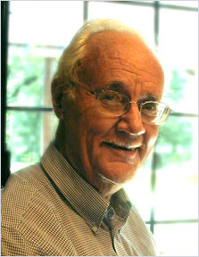
Introduction
The problem with worldviews is that they are largely unnamed, unexamined, and unassailable. It is particularly difficult to examine our own worldview because it is hard to think about what we are thinking with.
Paul Hiebert, Transforming Worldviews, 320

Slide 4
Important Initial Considerations:
We have to begin from within our own worldview.

Slide 5
Important Initial Considerations:
We have to begin from within our own worldview.
We have to begin with a certain level of “confident humility.”

Slide 6
Important Initial Considerations:
We have to begin with and from our own worldview.
We have to begin with a certain level of “confident humility.”
Most worldviews are not held for “strictly rational” reasons.

Slide 7
Important Initial Considerations:
Our Basic Initial Stance: Servant-Steward Learners

Slide 8
Important Initial Considerations:
Our Basic Initial Stance: Servant-Steward Learners
Humble and Joyful Service:

Slide 9
Important Initial Considerations:
Our Basic Initial Stance: Servant-Steward Learners
Humble and Joyful Service:
Careful Observation:

Slide 10
Important Initial Considerations:
Our Basic Initial Stance: Servant-Steward Learners
Humble and Joyful Service:
Careful Observation:
Seeking Understanding through Asking Thoughtful Questions and Genuinely Listening:

Slide 11
Important Initial Considerations:
Our Basic Initial Stance: Servant-Steward Learners
Biblically-informed and Discerning Analysis:

Slide 12
Important Initial Considerations:
Our Basic Initial Stance: Servant-Steward Learners
Biblically-informed and Discerning Analysis:
Biblically-informed and Spirit-filled Creative Application of What We Know and Are Discovering:

Slide 13
The Basic Dimensions of a Worldview:
Three Important Worldview Themes:

Slide 14
The Basic Dimensions of a Worldview:
Three Important Worldview Themes:
Cognitive Themes:

Slide 15
The Basic Dimensions of a Worldview:
Three Important Worldview Themes:
Cognitive Themes:
Concepts of Time and Space:

Slide 16
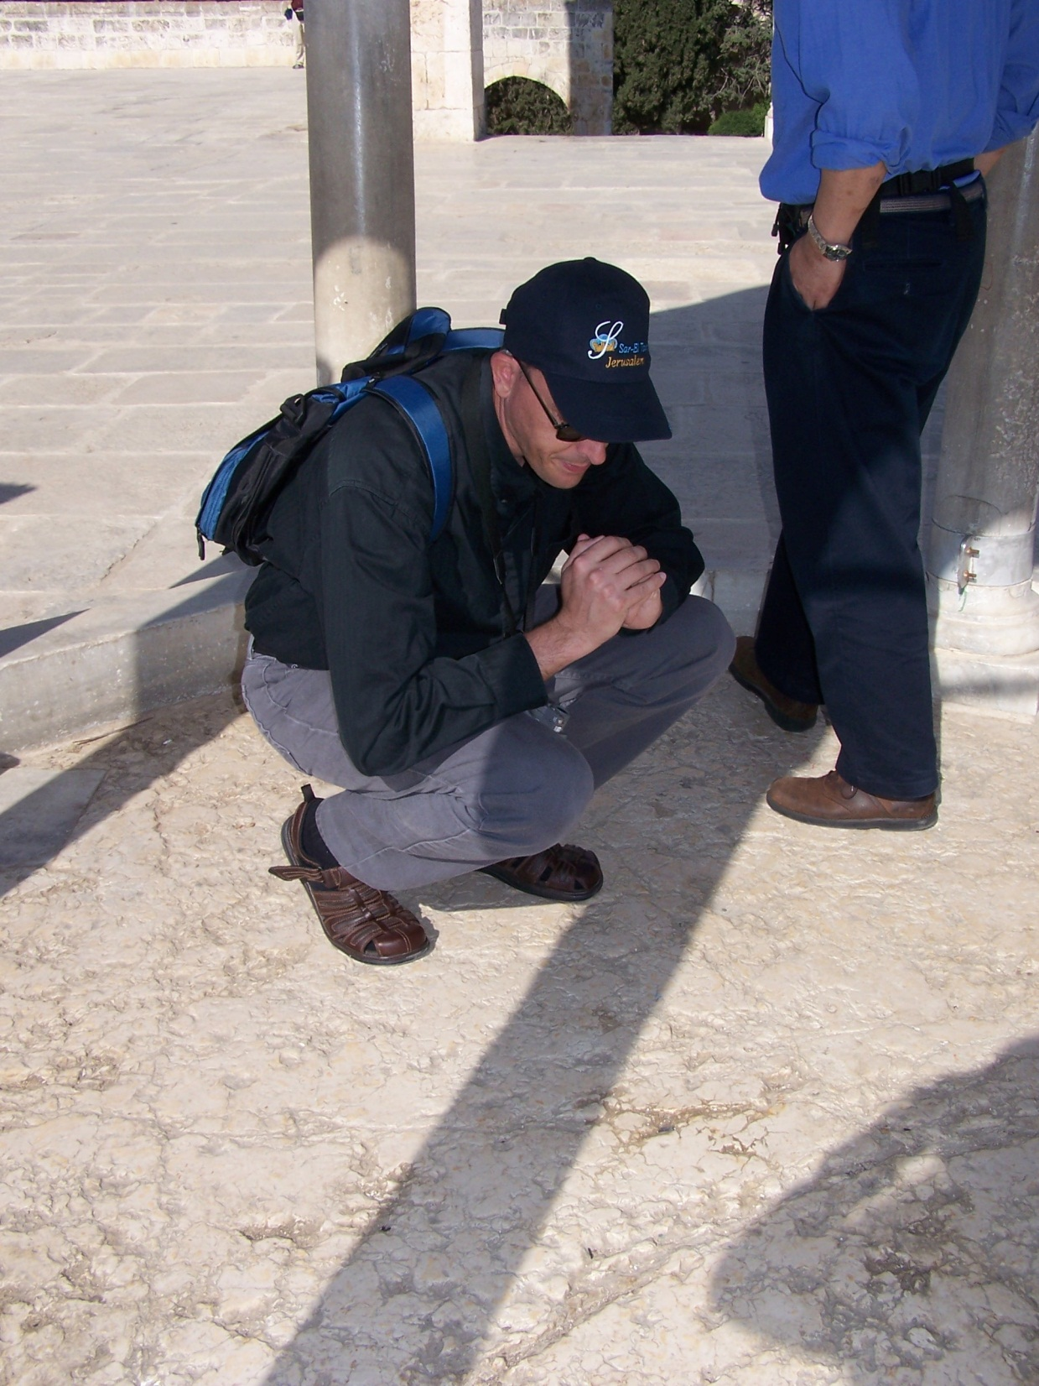

Slide 17
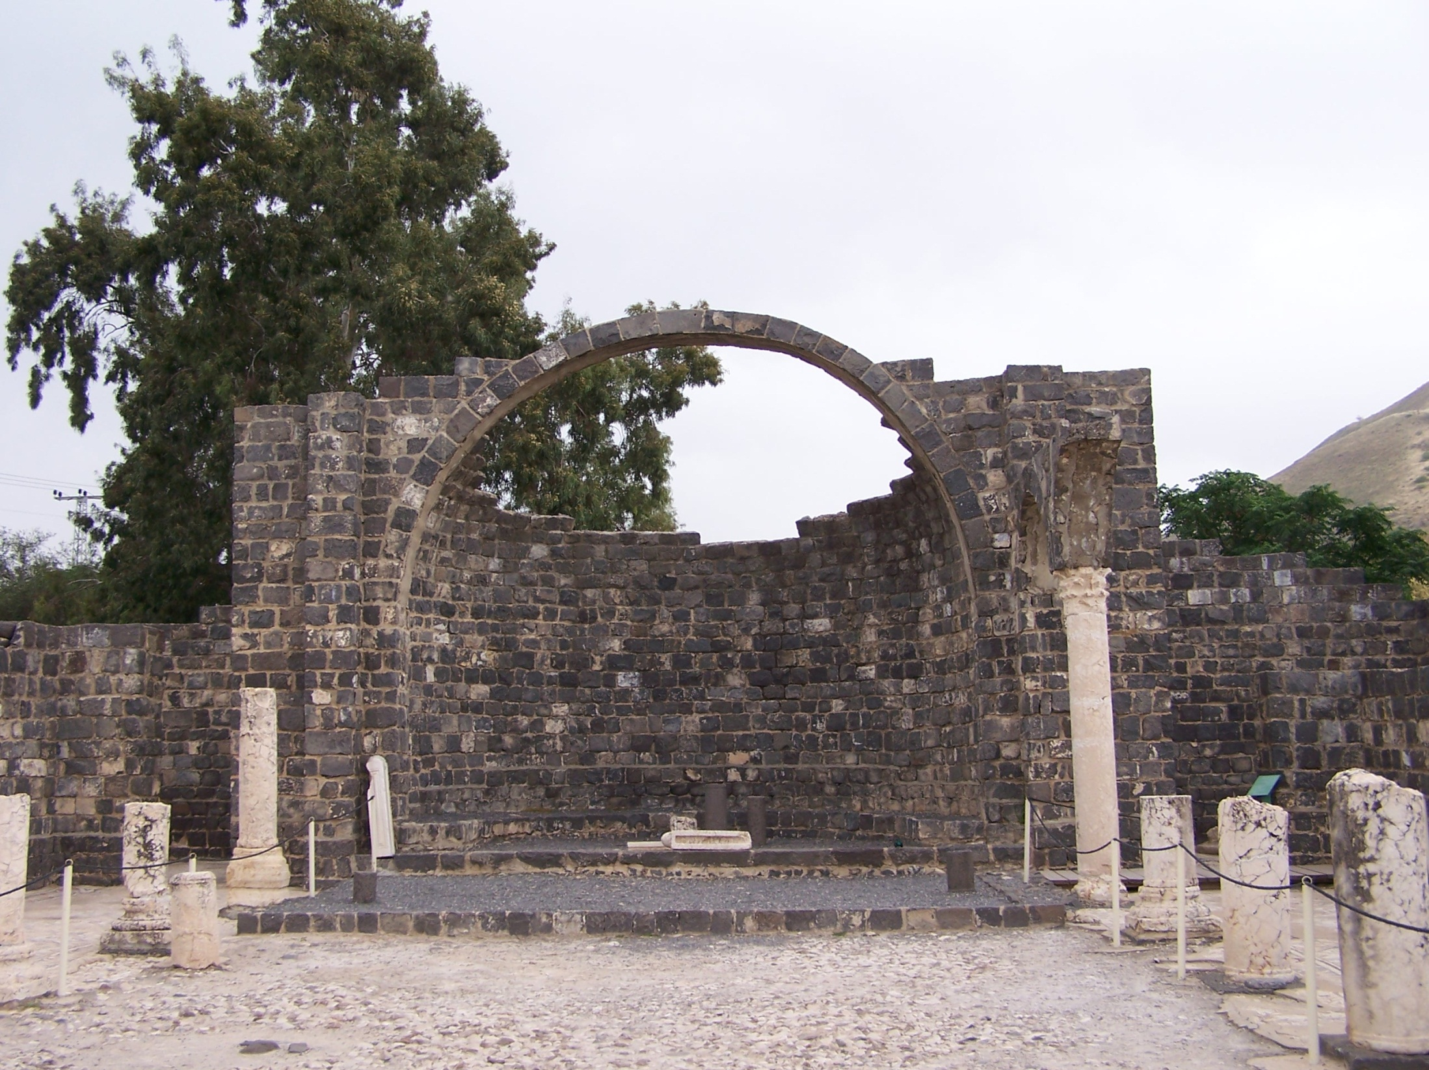

Slide 18
The Basic Dimensions of a Worldview:
Three Important Worldview Themes:
Cognitive Themes:
Concepts of Time and Space:
Synchronic and Diachronic Dimensions of Worldview Analysis:

Slide 19
The Basic Dimensions of a Worldview:
Three Important Worldview Themes:
Cognitive Themes:
Concepts of Time and Space:
Synchronic and Diachronic Dimensions of Worldview Analysis:
Root Metaphors: Organic and Mechanical:

Slide 20
The Basic Dimensions of a Worldview:
Three Important Worldview Themes:
Cognitive Themes:
Concepts of Time and Space:
Synchronic and Diachronic Dimensions of Worldview Analysis:
Root Metaphors: Organic and Mechanical:
Epistemologies:

Slide 21
The Basic Dimensions of a Worldview:
Three Important Worldview Themes:
Affective Themes:

Slide 22
The Basic Dimensions of a Worldview:
Three Important Worldview Themes:
Affective Themes:
Anger:

Slide 23
The Basic Dimensions of a Worldview:
Three Important Worldview Themes:
Affective Themes:
Anger:
Contentment:

Slide 24
The Basic Dimensions of a Worldview:
Three Important Worldview Themes:
Affective Themes:
Anger:
Contentment:
Indifference:

Slide 25
The Basic Dimensions of a Worldview:
Three Important Worldview Themes:
Affective Themes:
Anger:
Contentment:
Indifference:
Scorn:

Slide 26
The Basic Dimensions of a Worldview:
Three Important Worldview Themes:
Affective Themes:
Anger:
Contentment:
Indifference:
Scorn:
Sadness:

Slide 27
The Basic Dimensions of a Worldview:
Three Important Worldview Themes:
Affective Themes:
Anger:
Contentment:
Indifference:
Scorn:
Sadness:
Confusion:

Slide 28
The Basic Dimensions of a Worldview:
Three Important Worldview Themes:
Affective Themes:
Anger:
Contentment:
Indifference:
Scorn:
Sadness:
Confusion:
Shame:

Slide 29
The Basic Dimensions of a Worldview:
Three important Worldview Themes:
Evaluative Themes: Right and Wrong, Good and Evil, Normal and Defective, Proper and Improper:

Slide 30
The Basic Dimensions of a Worldview:
Three important Worldview Themes:
Evaluative Themes: Right and Wrong, Good and Evil, Normal and Defective, Proper and Improper:
Together, cognitive, affective, and evaluative assumptions provide people with a way of looking at the world that makes sense out of it, that gives them a feeling of being at home, and that reassures them that they are right.
Paul Hiebert, Transforming Worldviews, 65

Slide 31
The Basic Dimensions of a Worldview:
Dominant Cultural Systems to Notice:

Slide 32
The Basic Dimensions of a Worldview:
Dominant Cultural Systems to Notice:
Honor and Shame:

Slide 33
The Basic Dimensions of a Worldview:
Dominant Cultural Systems to Notice:
Honor and Shame:
Power and Fear:

Slide 34
The Basic Dimensions of a Worldview:
Dominant Cultural Systems to Notice:
Honor and Shame:
Power and Fear:
Guilt and Innocence:

Slide 35
The Basic Dimensions of a Worldview:
Dominant Cultural Systems to Notice:
Honor and Shame:
Power and Fear:
Guilt and Innocence:
No culture exhibits only one theme, but usually one dominates over the other two.

Slide 36
The Basic Dimensions of a Worldview:
Dominant Cultural Systems to Notice:
Honor and Shame:
Power and Fear:
Guilt and Innocence:
No culture exhibits only one theme, but usually one dominates over the other two.
What does all this mean and how does it help us in worldview analysis?

Slide 37
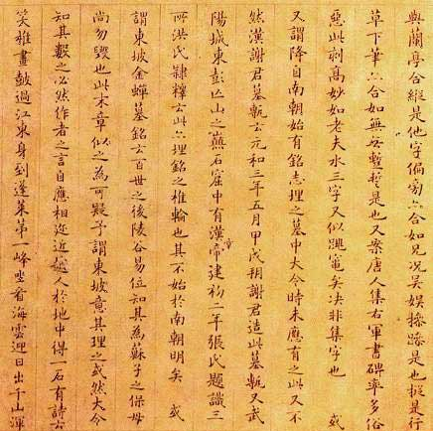
Some Helpful Tools for Analyzing Worldviews:
Linguistic (Ethnosemantic) Analysis:

Slide 38
Some Helpful Tools for Analyzing Worldviews:
Linguistic (Ethnosemantic) Analysis:
Cultural Sign Analysis:

Slide 39
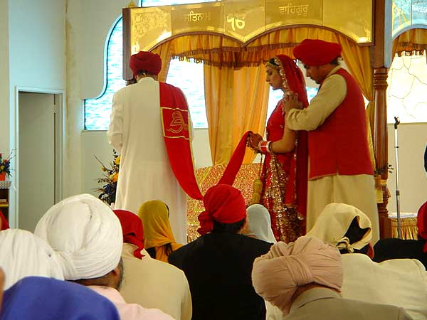
Some Helpful Tools for Analyzing Worldviews:
Linguistic (Ethnosemantic) Analysis:
Cultural Sign Analysis:
Ritual Analysis:

Slide 40
Some Helpful Tools for Analyzing Worldviews:
Linguistic (Ethnosemantic) Analysis:
Cultural Sign Analysis:
Ritual Analysis:
Folklore and Myth and Wisdom Literature Analysis:

Slide 41
Some Helpful Tools for Analyzing Worldviews:
Linguistic (Ethnosemantic) Analysis:
Cultural Sign Analysis:
Ritual Analysis:
Folklore and Myth and Wisdom Literature Analysis:
Aesthetic Analysis:

Slide 42
Some Helpful Tools for Analyzing Worldviews:
Linguistic (Ethnosemantic) Analysis:
Cultural Sign Analysis:
Ritual Analysis:
Folklore and Myth and Wisdom Literature Analysis:
Aesthetic Analysis:
Utilize Intercultural Comparisons:

Slide 43
Some Helpful Tools for Analyzing Worldviews:
Linguistic (Ethnosemantic) Analysis:
Cultural Sign Analysis:
Ritual Analysis:
Folklore and Myth and Wisdom Literature Analysis:
Aesthetic Analysis:
Utilize Intercultural Comparisons:
Look for Informants:

Slide 44
A Few Closing Questions For Further Consideration:
Does the worldview adequately represent reality?

Slide 45
A Few Closing Questions For Further Consideration:
Does the worldview adequately represent reality?
Does the worldview really explain what it claims to explain?

Slide 46
A Few Closing Questions For Further Consideration:
Does the worldview adequately represent reality?
Does the worldview really explain what it claims to explain?
Is the worldview subjectively satisfying?

Slide 47
A Few Closing Questions For Further Consideration:
Does the worldview adequately represent reality?
Does the worldview really explain what it claims to explain?
Is the worldview subjectively satisfying?
Does it coincide with a biblical worldview?

Slide 48
Conclusion:

Slide 49
Black

Slide 50
Worldview link at BibleStudyDownloads.org
Get this presentation for free!
Notes:
WV (Worldviews)

